Slide 1



Lecture 9: Users and User Security
COMP260: Distributed Systems
BSc (Hons) Computing for Games

Slide 2
Today’s session:
SQL
Password-based User Accounts
Adding User Accounts to GaaS
Workshop preview

Slide 3
SQL

Slide 4
SQL
Did your experiments in SQL yield success last week?
SQL CRUDS testbed
SQL SUD – dungeon database
Persistent SUD
SQL MUD

Slide 5
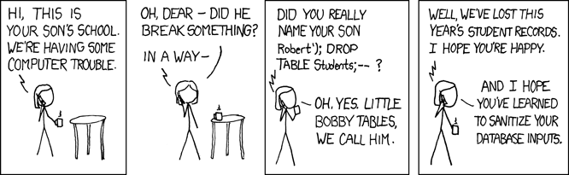
SQL
SQL Injections
Typically, add extra data to input data to allow extra SQL commands to be called
Hence input santitation

Slide 6
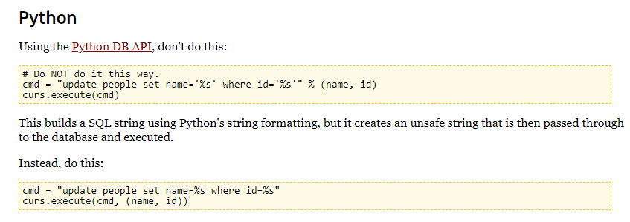

SQL
SQL Injections
http://bobby-tables.com/python.html

Slide 7
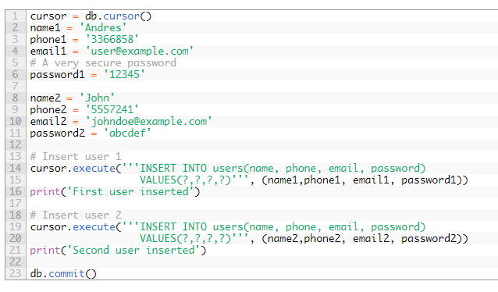
SQL
SQL Injections
https://www.pythoncentral.io/introduction-to-sqlite-in-python/

Slide 8
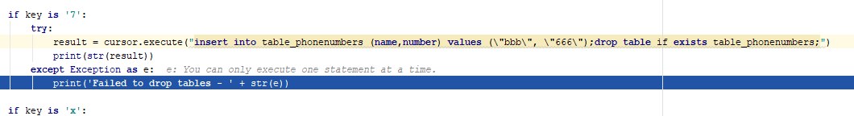
SQL
SQL Injections
Obviously, I thought I’d have a go
Python sqlite implementation may be more robust than we give it credit for

Slide 9
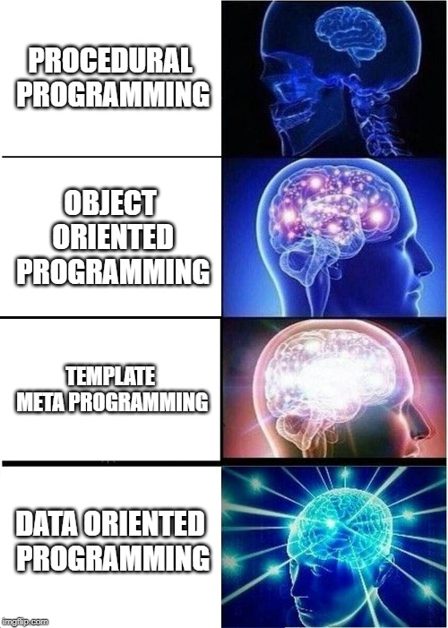
SQL
Data oriented programming

Slide 10
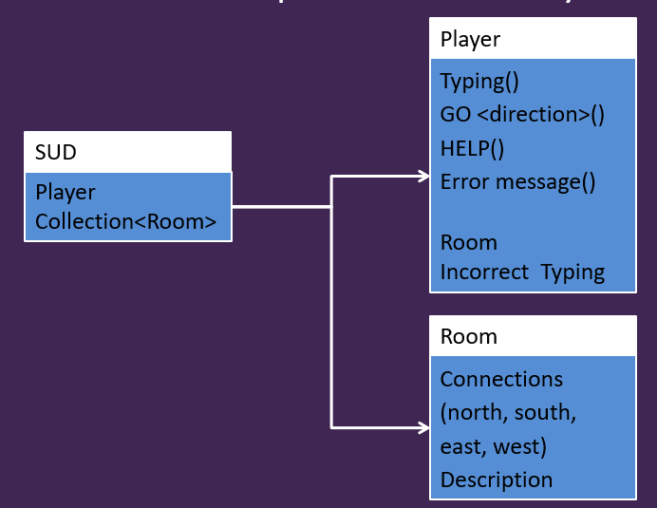
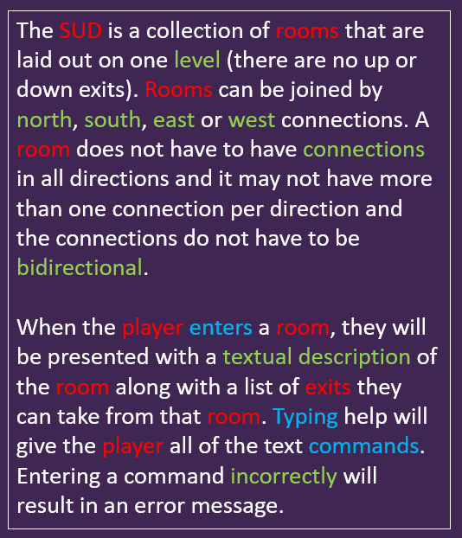
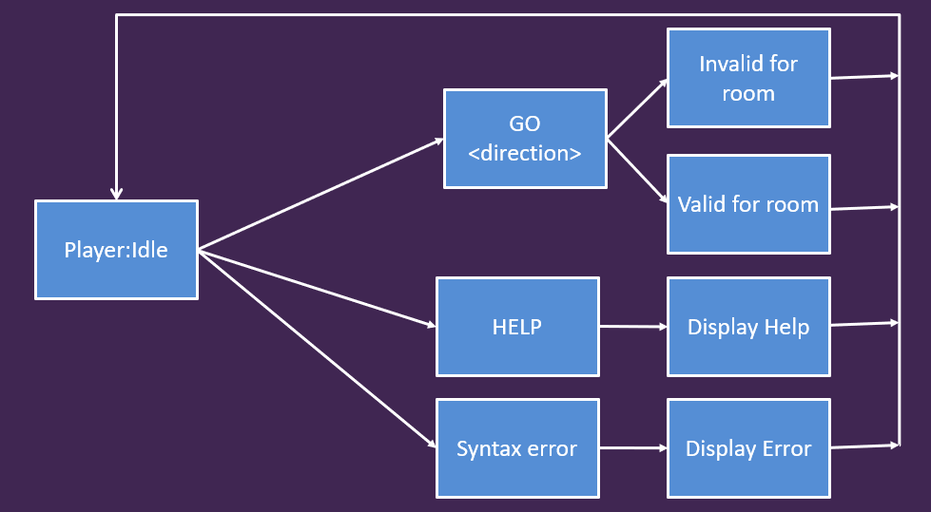
SQL
Data oriented programming
We’ve seen that OOA / OOD / OOP gives us a powerful paradigm to go from loose textual requirements to form (class hierarchies / component & package) and function (flowcharts, state diagrams, activity diagrams etc)

Slide 11
SQL
Data oriented programming
OOA / OOD / OOP works really well, until we end up with large class hierarchies
By large
Lots of depth (base-r / parent classes)
Lots of width (derived classes per base/parent class)
2 killer problems
1. compile time
Touching baser-class definition will lead to large rebuilds
Can be a performance issue in C++
2. designer impact
Designers need to touch their data
Having it defined in code may not be the best place for this
To a degree, Unity side-steps this with the Inspector, but it’s not a perfect vehicle and struggles under scale

Slide 12
SQL
Data oriented programming
With data orientation
Move game data that is important to designers into frameworks that they can work on WITHOUT involving programmers
Make game architecture more generic and less hierarchical
Databases / designer legible formats (SQL, Excel, XML) are good for this

Slide 13
SQL
Data oriented programming
An Example: Underzone Game
This game has 20 weapons that are shared between player and baddies
Guns, lasers and bombs
Each has their own ammo and damage types, vfx, sfx, in-game text and so on
Also have their own level ups (procedural weapons)
Damage, range, speed, spread, blast radius, shot time, dps etc
TL;DR
Lots of weapons for player and baddies
Lots of data that I (programmer) don’t want to touch

Slide 14
SQL
Data oriented programming
With OOD/P
Build a massive class hierarchy and populate with each weapon
How do we distinguish between baddie and player weapon approaches?
if(is_baddie_owner == true)
How do we manage all the weapon data?
Store in class and let designers work with it?
Often end up with a lot of copypasta lightweight derived classes (1-4)
Base
Weapon
Laser
Weapon
Bomb
Weapon
Bullet
Weapon
1
2
3
4
1
2
3
4

Slide 15
SQL
Data oriented programming
With DOA
1. Build a different class hierarchy
Base
Weapon
Laser
Weapon
Bomb
Weapon
Bullet
Weapon
Baddie
Laser
Weapon
Player
Laser
Weapon
Baddie
Bullet
Weapon
Player
Bullet
Weapon

Slide 16
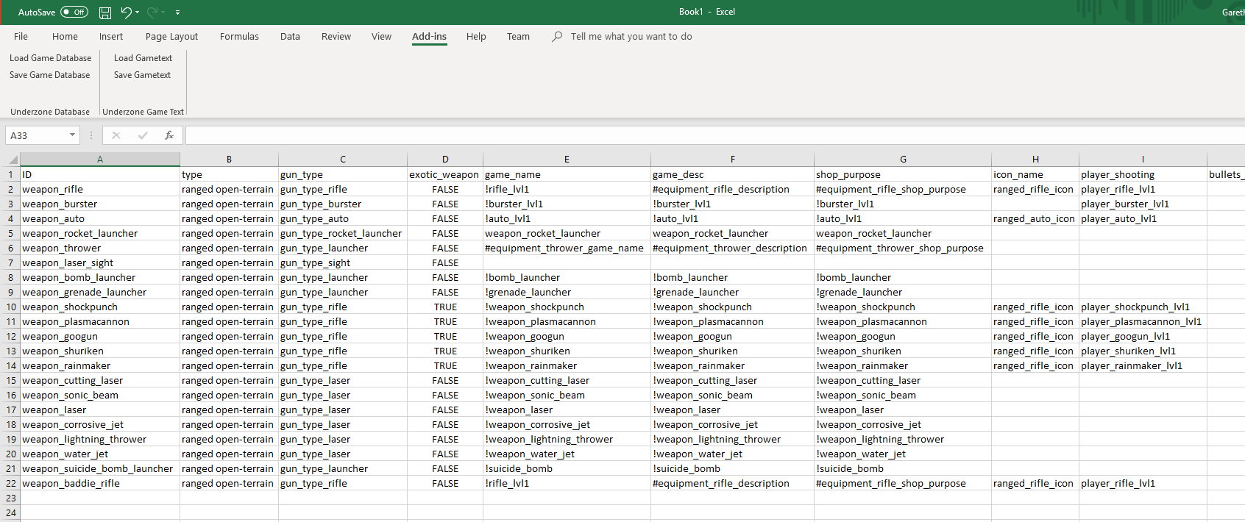
SQL
Data oriented programming
With DOA
2. Put all the weapon definitions in a database and let designers populate and manage
21 weapons x 30 attributes

Slide 17
SQL
Data oriented programming
With DOA / DOP
3. End up with fatter base classes (weapon & player / baddie weapon)
But data modelling is divorced from code (which is good)
Makes it very easy to share functionality, stats and fx between player and baddie (or make them different)
Gives designers control over game content
If they want 2 dozen more weapons, go for it
Gives programmers control over systems
Main concern is the way entities work and the fundamental differences between different entities

Slide 18


Password-based User Accounts
All your passwords are terrible
And you are terrible too

Slide 19
Password-based User Accounts
Adding passwords to accounts is a dictionary
<username, password>
Which we can store in a database

Slide 20
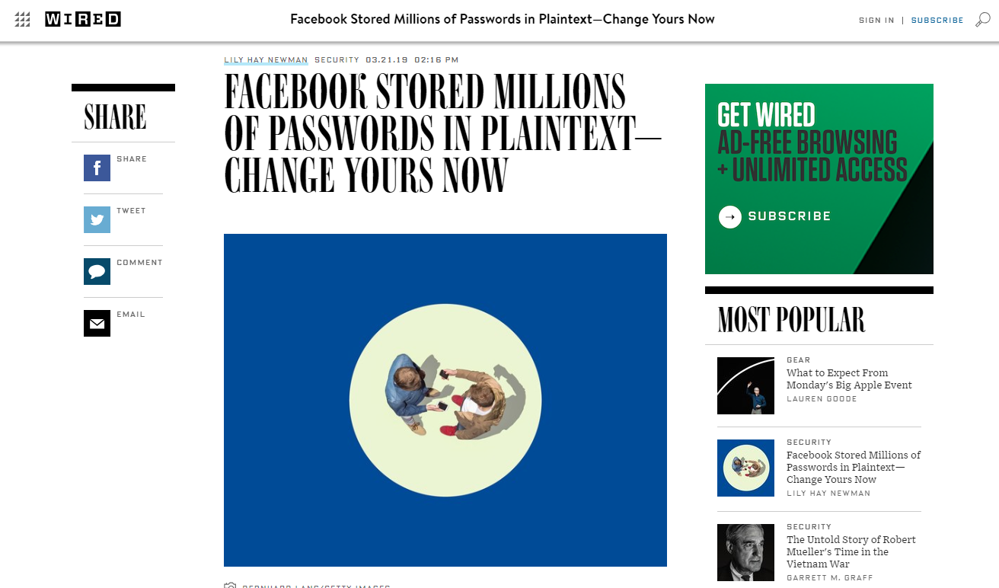
Password-based User Accounts
Storing passwords as plain-text is terrible

Slide 21
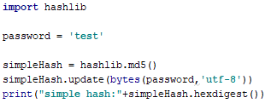
Password-based User Accounts
To store passwords, they should be hashed
i.e. we store the result of a transformation and not the raw data
Then, we can compare a transformed password with the known hash
Hash should be unique for the data provide
In Python, hashlib provides a library of hashing functions
Other hashes are available as we all know that md5 is rubbish

Slide 22
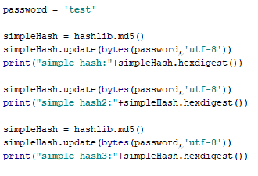
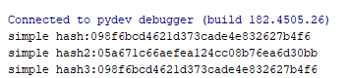
Password-based User Accounts
NB
Hashes are calculated on the bytes that they have consumed, so use a new has every time
Also, md5 is normally used to validate data integrity as a checksum rather than password hashing

Slide 23
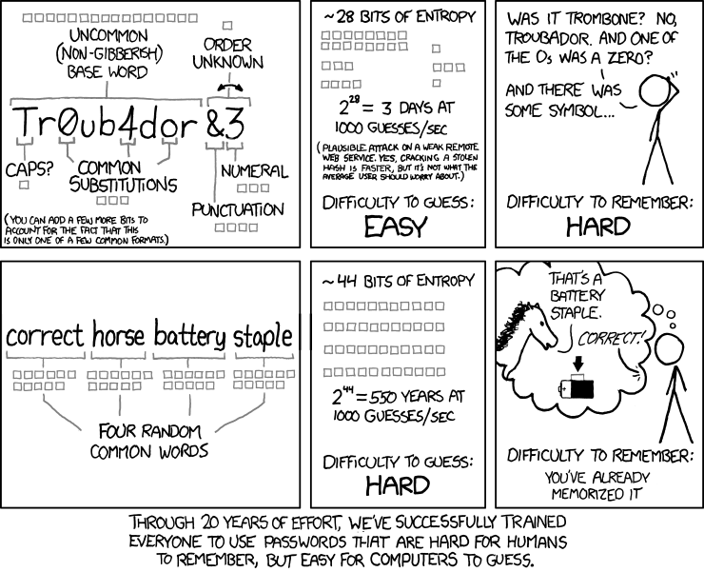
Password-based User Accounts
Making harder to crack passwords – approach 1

Slide 24
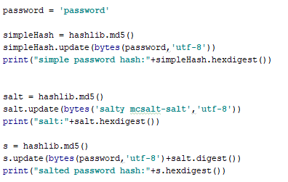
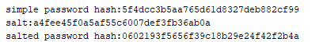
Password-based User Accounts
Making harder to crack passwords – approach 2
Adding more data to the hash makes it harder to crack, but harder to remember
Let’s help users by adding gibberish to their password and remembering the gibberish part
Salting

Slide 25
Password-based User Accounts
Making harder to crack passwords – approach 2
We store
<username, (password hash, salt)>
Good practice to make salts individual
Not based on user name ;)
Can send hashes and salts around
They shouldn’t make it easier to reverse engineer the original password

Slide 26
Adding User Accounts to GaaS

Slide 27
Adding User Accounts to GaaS
Need to think about the application in terms of:
Form, function and datacoms (like assignment 1)
db model & ui/ux

Slide 28
Adding User Accounts to GaaS
Form
Should be no real changes
Function
States of the server
Client connected, but not logged in
Client connected and logged in
Client lost
States of the client
Not connected to server
Connected, but not logged in
Connected and logged in
Disconnected and logged in
Not connected and no account with server

Slide 29
Adding User Accounts to GaaS
Datacomms: New User
Client.Create new User
Server
Enter Credentials
{username}
username exists
New user failed
Creation failed
Creation(failed)
Client.Create new User
Server
Enter Credentials
{username}
user does not exist
Salt password
{salt}
Send salt
Enter Credentials
{username, password hash}
Create account
Receive::Thread()
Welcome message
Creation(success)

Slide 30
Adding User Accounts to GaaS
Datacomms: Returning User
Client.Login
Server
Enter Credentials
{username}
user does not exist
Report Failure
{user unknown}
Send failure message
Client.Login
Server
Enter Credentials
{username}
user exists
Salt password
{salt}
Send salt
Enter Credentials
{username, salted password}
Check user hash
Report Failure
{user/password wrong}
Hash failed

Slide 31
Adding User Accounts to GaaS
Datacomms: Returning User
Client.Login
Server
Enter Credentials
{username}
user exists
Salt password
{salt}
Send salt
Enter Credentials
{username, salted password}
Check user hash
Report Success
{welcome message}
Hash succeeds

Slide 32
Adding User Accounts to GaaS
Database model
Table for rooms
Table for users
User name (unique)
Hashed password
Salt
<other data>

Slide 33
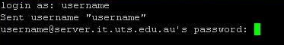
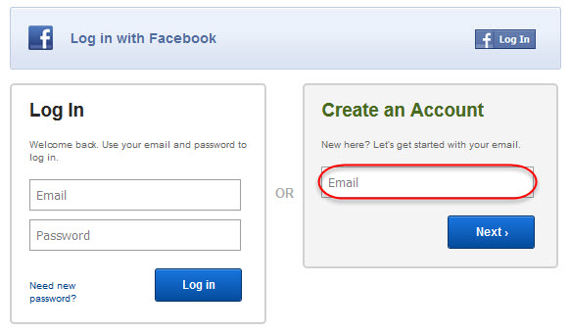
Adding User Accounts to GaaS
UI / UX
How do you manage the UX for creating accounts and logging into your service?
Use the existing command line interface of your MUD?
Add a modal dialog?

Slide 34
Workshop preview
Add secure accounts to your MUD
Do in stages:
1. Command line password tool
2. Command line password too with SQL support
3. Retrofit into SUD with appropriate UI
4. Move functionality into MUD

Slide 35
Questions

